Slide 1
DJANGO PERSONAL WEBSITE PROJECT
FERNANDO LÓPEZ RAMÍREZ

Slide 2
INITIAL PROJECT CONFIGURATIONS AND SOME THEORY

Slide 3
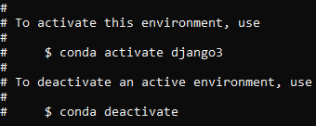
CREATE NEW ENVIROMENT
conda create –n django python==3.7

Slide 4
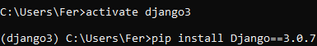
INSTALL DJANGO INSIDE THE ENVIROMENT
pip install Django==3.0.7
CHECK IF THE INSTALATION WAS SUCCESFULL BY CONSULTING THE VERSION OF DJANGO
python –m django --version

Slide 5
CREATE PROJECT
django-admin startproject (name of the project)
VIRTUAL ENVIROMENT
COMMAND TO CREATE A DJANGO PROJECT

Slide 6
INSTALL PYLINT (SIRVE PARA LA SINTAXIS QUE NOS MUESTRA EL EDITOR, SIEMPRE INSTALARLA CUANDO HACEMOS NUEVOS ENTORNOS VIRTUALES)
conda install pylint
VIRTUAL ENVIROMENT
COMMAND TO INSTALL PYLINT

Slide 7
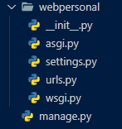
DJANGO FILES.
MANAGE.PY
MANAGE ALL THE PROJECT FROM THE COMMAND PROMPT.

Slide 8
DJANGO FILES.
SUBDIRECTORY
CONTAINS THE BASE SCRIPTS OF THE PROJECT WICH INCLUDES ALL THE INITIAL CONFIGURATION AND DEPLOYMENT.

Slide 9
DJANGO FILES.
_INIT_.PY: TELL US THE FOLDER IS A PACKAGE.
SETTINGS.PY: CONTAINS ALL THE PROJECT CONFIGURATION.
URLS.PY: CONTROLS THE WEB DIRECTIONS (URLs)
WSGI.PY: SCRIPT THAT CONTAINS THE INFO IN ORDER TO DEPLOY THE PROJECT IN PRODUCTION.

Slide 10
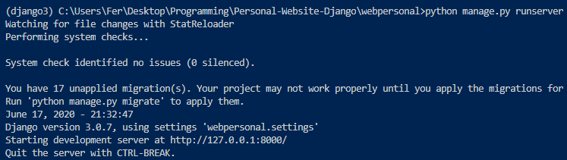
RUN TEST SERVER
python manage.py runserver

Slide 11
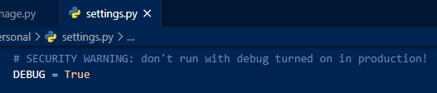
PRODUCTION MODE OR TESTING
IF YOU ALREADY WANT TO DEPLOY YOUR APP, YOU MUST SET DEBUG TO FALSE, OTHERWISE YOU CAN LEAVE IT SET IN TRUE AS LONG AS YOU ARE TESTING/DEVELOPING YOUR APP.

Slide 12
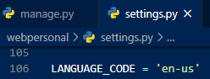
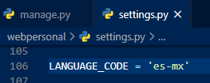
DJANGO IS INTERNATIONAL, SO YOU CAN CHANGE THE DEFAULT LANGUAGE
ENGLISH – UNITED STATES
ESPAÑOL -MÉXICO

Slide 13
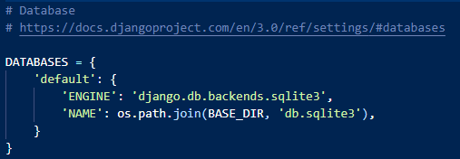
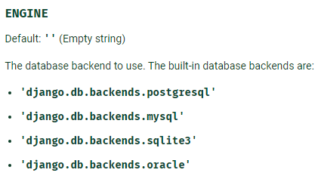
CREATE DATA BASE SO DJANGO CAN MANAGE SOME CONFIGURATIONS OF THE ADMIN (USER SESSIONS, USERS, GROUPS)
BY DEFAULT DJANGO CONFIGURES A SQLITE3 DATABASE, BUT DJANGO CAN SUPPORT ANOTHER ENGINES LIKE: POSTGRESQL, MYSQL, SQLITE3 AND ORACLE.

Slide 14
SYNCHRONIZE DATA BASE SO IT CAN BE USED.
python manage.py migrate
VIRTUAL ENVIROMENT
COMMAND TO SYNCHRONIZE DATA BASE

Slide 15
APPS

Slide 16
What are they?
Django uses a system that reuses "apps", it is something like internal applications that implement specific functionalities.
The active apps are set in the settings.py file, in the list installed_apps.
A, B, C, D, E, F
A, B, C
PROJECT 1
APPS
B, F, D
PROJECT 2
C, E, F
PROJECT 3

Slide 17
APP CORE

Slide 18
CREATE AN APP
python manage.py startapp (name of the app)
VIRTUAL ENVIROMENT
COMMAND TO CREATE AN APP

Slide 19
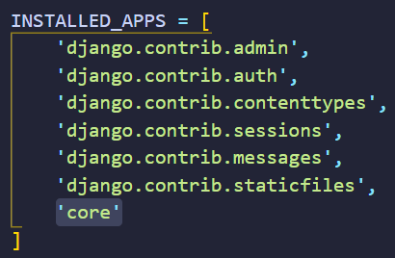
ACTIVATE THE APP IN SETTING.PY

Slide 20
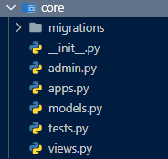
WHAT I GET WHEN I CREATE AN APP?
YOU GET A NEW DIRECTORY WITH MORE NEW SCRIPTS.
ONE OF THE MOST IMPORTANTS ARE VIEWS.PY.
IN THE VIEWS.PY SCRIPT IS WHERE THE VIEWS OF AN APP ARE DEFINED. A VIEW MAKES REFERENCE TO THE LOGIC THAT IS EXECUTED WHEN WE GET A REQUEST TO OUR WEB.

Slide 21
CREATE A VIEW TO PROCESS THE REQUEST TO THE ROOT OF OUR WEBSITE.

Slide 22
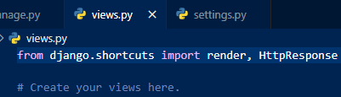
REDIRECTING
WE NEED TO IMPORT THHE HttpResponse() METHOD, THIS ONE ALLOW US TO RESPONSE A REQUEST WITH A SCRIPT.
Render() WAS ALREADY IMPORTED

Slide 23
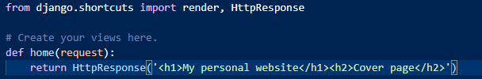
SENDING SOME HTML SIMPLE CODE

Slide 24
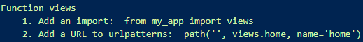
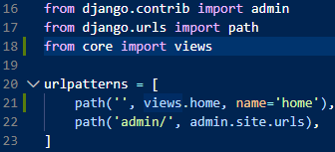
IMPORT CORE VIEWS IN URLS GLOBAL SCRIPT

Slide 25
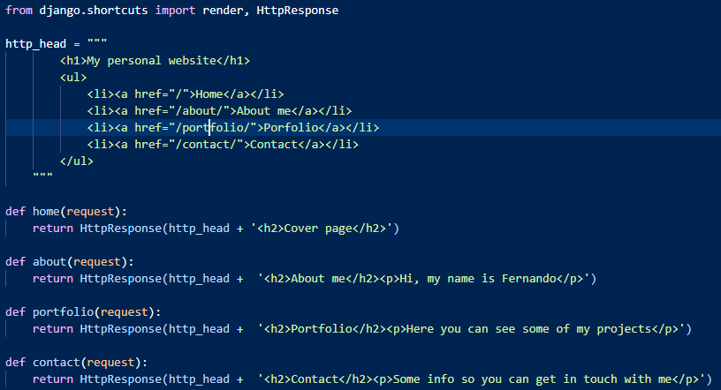
EXTENDING APP CORE

Slide 26
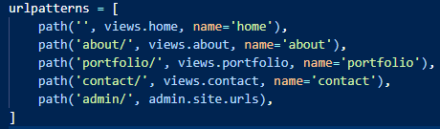

Slide 27
INTRODUCTION TO TEMPLATES

Slide 28
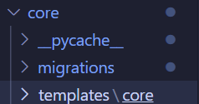
CREATE A FOLDER CALLED TEMPLATES WITH ANOTHER FOLDER INSIDE WITH THE NAME OF THE APP IN USE

Slide 29
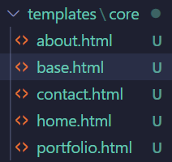
HERE WE CAN CREATE OUR TEMPLATES, BUT REMEMBER DO NOT REPEAT, THAT IS WHY WE HAVE A BASE FILE.

Slide 30
TEMPLATE TAG BLOCK & EXTENDS

Slide 31
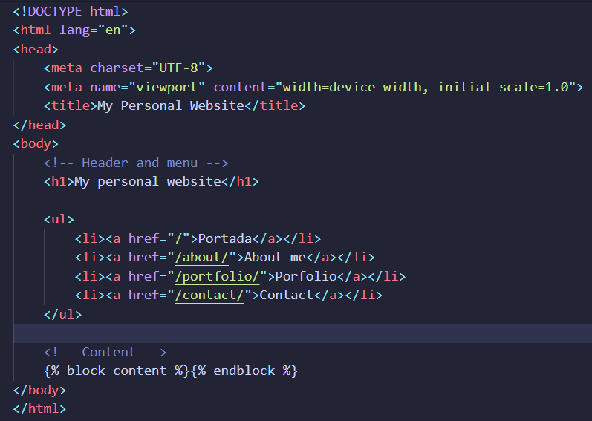
WITH TEMPLATE TAGS WE CAN ADD BLOCKS OF DYNAMIC CONTENT FROM DIFFERENT TEMPLATES. HERE WE CREATE OUR TEMPLATE TAG CONTENT…
USING TEMPLATE TAG BLOCK

Slide 32
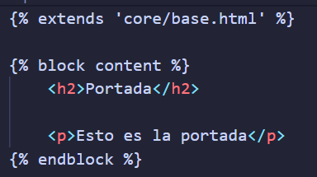
IF WE WANT TO USE IT IN “HOME.HTML” WE EXTEND THE TEMPLATE WHERE WE HAVE THE TEMPLATE TAGS AND THEN THE TEMPLATE TAG. IN THIS CASE: CONTENT.
USING TEMPLATE TAG EXTENDS
TEMPLATE INHERITANCE

Slide 33
TEMPLATE TAG URL
Always use template tag instead of RAW URLS

Slide 34
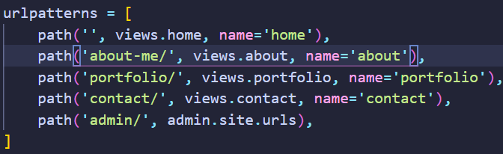
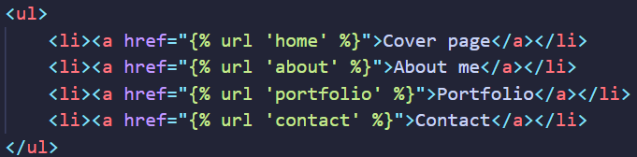
WITH THE TEMPLATE TAG URL WE CAN HAVE DYNAMIC URLS THAT ALLOW US TO MAKE CHANGES JUST ONE TIME (IN THE URLS.PY) AND WE DON’T HAVE TO DO ANYTHING IN THE BASE.HTML FILE. IT WILL AUTOMATICALLY KNOW WICH URL TO TAKE.
BASE.HTML
URLS.PY

Slide 35
DOCUMENTATION OF TEMPLATE TAGS, LOOPS, FILTERS, VARIABLES, ETC.
https://docs.djangoproject.com/en/3.0/ref/templates/language/

Slide 36
DOCUMENTATION OF BUILT-IN TEMPLATE TAGS AND FILTERS
https://docs.djangoproject.com/en/3.0/ref/templates/builtins/

Slide 37
STATIC RESOURCES
Django development server is not capable of handling static files by default. This would be handled (in the deployment phase) by servers like Enginex or Apache. We cannot see how the page is viewed in the development phase. So we must make a series of configurations so that the Django development server can serve this type of files.

Slide 38
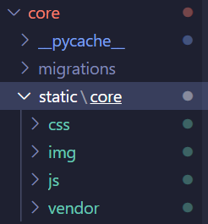
Create a folder called static followed by a subdirectory called exactly like the name of the app you are. Then upload your files in this directory

Slide 39
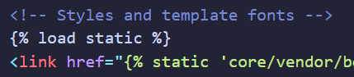
Then you must add a template tag called {% load static %} before all the css links and js files.

Slide 40
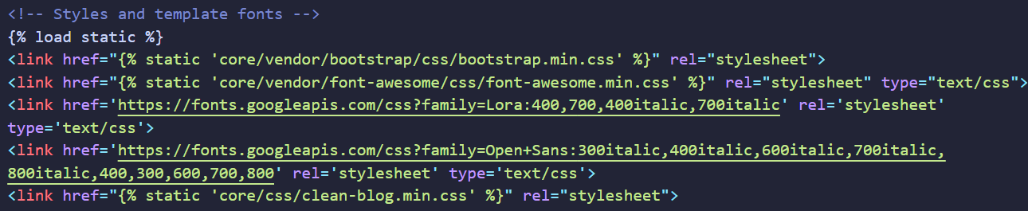
After that you have to redirect all your static content with the template tag {% static ‘(your_file)’ %}

Slide 41

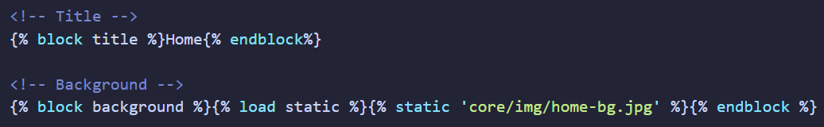
Before using a static file, we had to uploaded it with the template in the memory. And we did that with the Load Static command {% load static %}
MAKE SURE THIS GOES IN ONE LINE

Slide 42
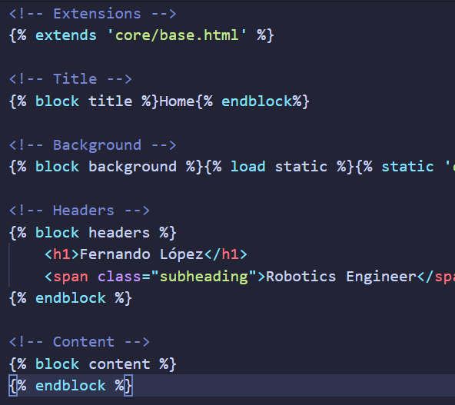
Our template tags so far are looking like this in every template (home, contact, portfolio and about).

Slide 43
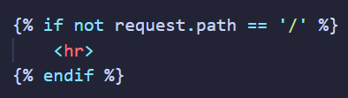
We use request.path to know in which page we are. And in this case we are using it to add a hr tag if we are not in the home page.

Slide 44
APP PORTFOLIO

Slide 45
WHAT WE’LL DO IN THE NEXT SLIDES:
1. Create an app called portfolio.
2. Dynamic portfolio by making it interact with a DB.
3. Learn how to define models.
4. Learn how to use the admin panel.

Slide 46
So Django can manage images, we must install an extension called pillow in our enviroment with the next command:
pip install Pillow

Slide 47
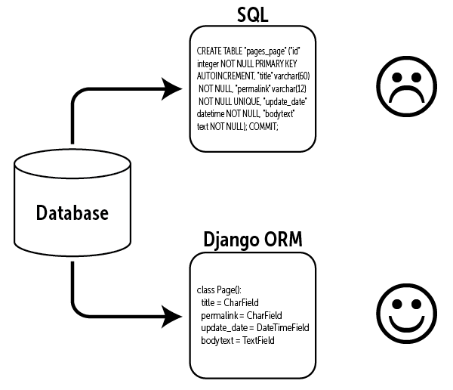
Object Relational Model (ORM).
We can work with object mapped in the Data Base so when we create an instance of an especific class, these will automatically be storage as registers and when we use them or change them those registers also will be saved in the Data Base.
In Django this “classes” are called models.

Slide 48
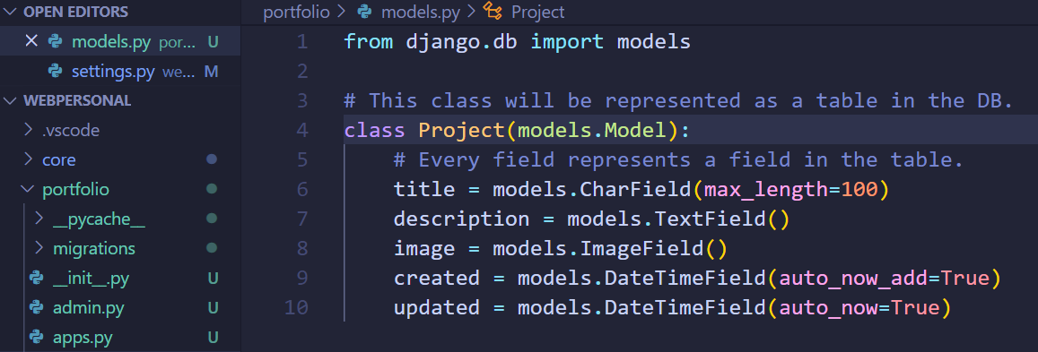
Create a model Project that inheritance from models.Model. auto_now_add → automatically adds current date and time just when the instance is created for the first time. auto_now → change the field with the current date and time every time the instance is modified.

Slide 49
ADMIN PANEL

Slide 50
So we can access to the admin panel, we must create a superuser:
python manage.py createsuperuser

Slide 51
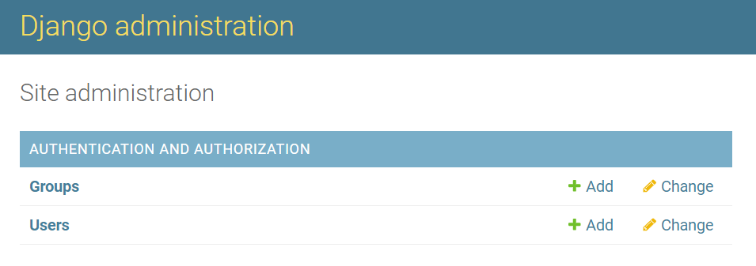
And now we can access to the admin panel, but we don’t see our model. For that we need to register our model in the admin.py file

Slide 52
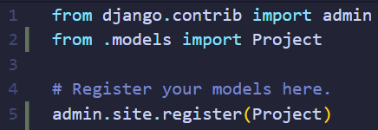
We must import our model and register it with the line: admin.site.register(model_name)

Slide 53
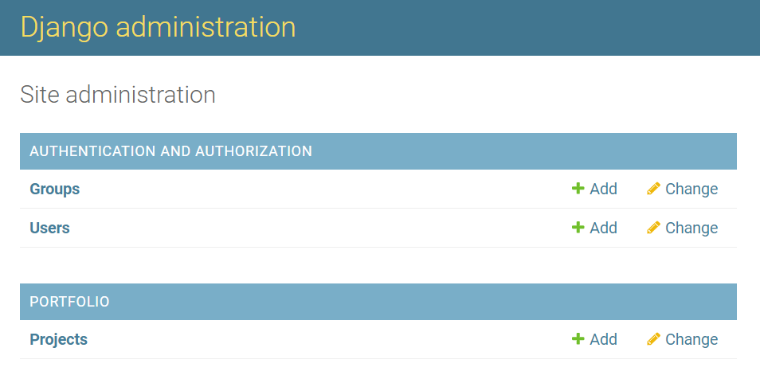
And now we have it

Slide 54
CUSTOM ADMIN PANEL (1)

Slide 55
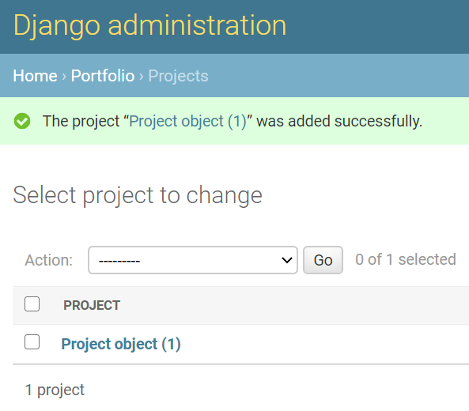
By now, we can create a project in the admin panel of django, but what we got is this:
Project object (1)

Slide 56
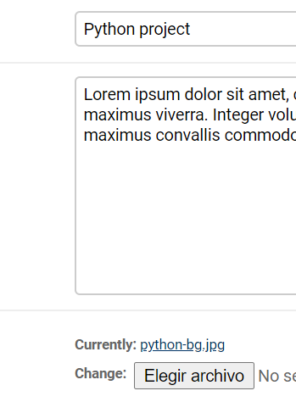
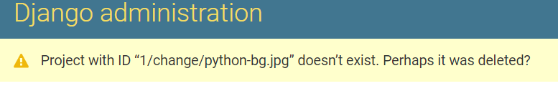
And if we want to open the image, it doesn’t work.

Slide 57
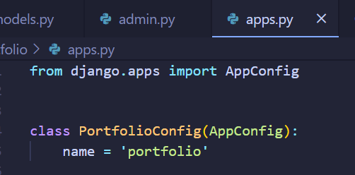
By default we see (in our app.py file) that there is a class with the name “portfolio” (which is the name of the app we are)…

Slide 58
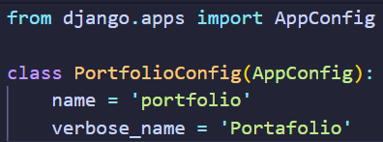
We cannot change this just like that, we must add an extended field called verbose_name that allows us to define a public name to our app. And once we’ve done that, we must say to Django to use this app configuration

Slide 59
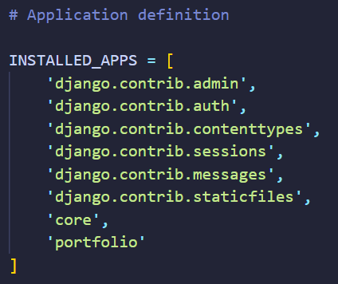
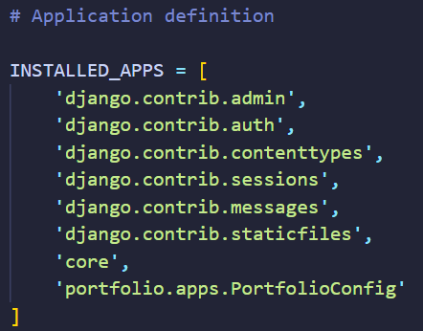
And once we’ve done that, we must say to Django to use this app configuration in the settings.py file like is shown in the images. We access to the app folder from our portfolio app and finally we access to the class with the configuration we just made.
BEFORE
AFTER

Slide 60
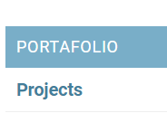
So instead of use the last name ‘Portfolio’, Django will use the verbose_name field with the name ‘Portafolio’

Slide 61
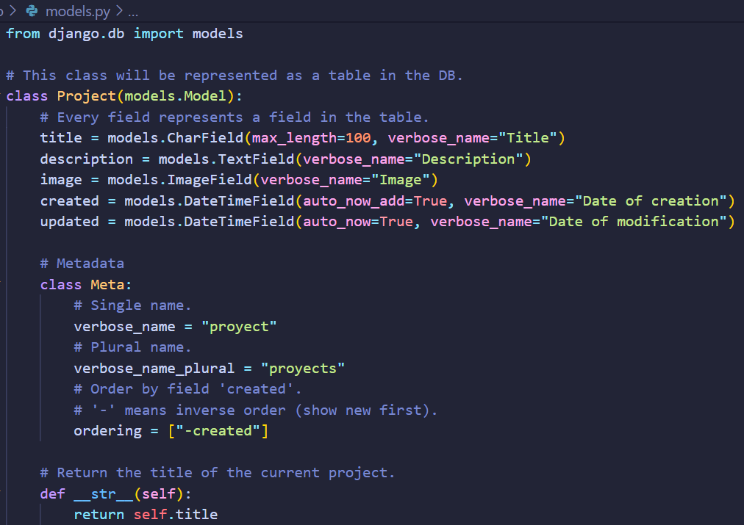
This is how our model of the Project looks like. We have a subclass Meta where we define the verbose name in singular and plural. Also the ordering that we want to display the registers (in this case is inverse and ordered by the ‘created’ field). The method __str__ is to show the title instead of “Project object (#)”

Slide 62
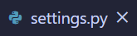
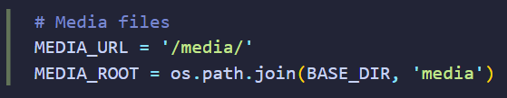
Generate an extended configuration for the media files
We are saying that from now all the media files are going to be storage in the ’media’ folder.

Slide 63
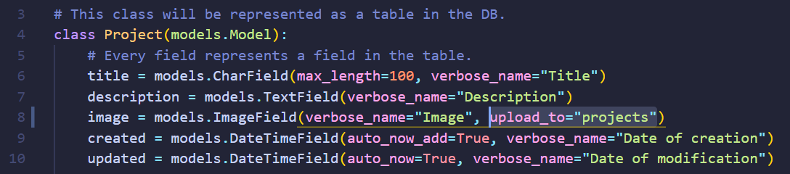
But what if we have more models and more images to storage…? That is why we need a better organization. For that we are going to add an attribute to our image field (in our model): upload_to.
What we are saying is that all the file media our users upload… are going to be storaged in the directory “projects”. This attribute (upload_to) will create a folder with the name “projects” inside of the “media” folder. (LINE 8)

Slide 64
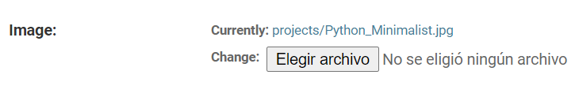
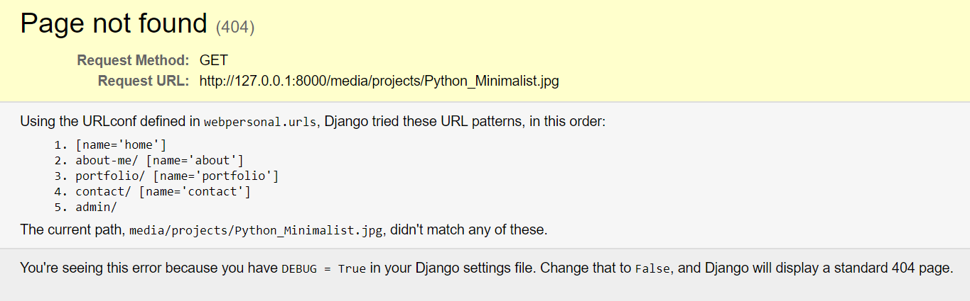
But if we click down to see the image we still got an error. This is due because the development server of Django by default cannot serve this files, this usually takes charge a server like Apache or Ngix.
So, how can we see the media files in the development enviroment?
Well, we can as long as we keep the DEBUG variable as True and adding an extended configuration to Django

Slide 65
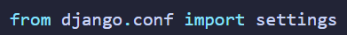

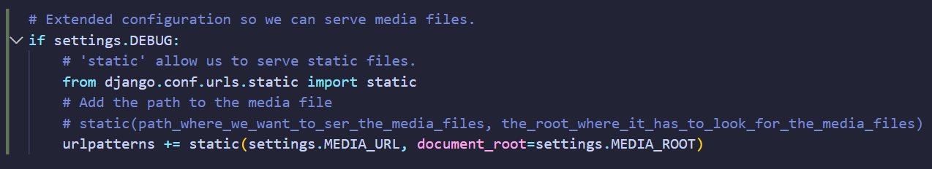

Extended configuration to Django so we can serve media files
Here is where we use the MEDIA_URL and MEDIA_ROOT variables we created in the settings.py file

Slide 66


Slide 67
Modelo Vista Template (MVT)

Slide 68


Slide 69


Move template and views of portfolio from the app core to the app portfolio.

Slide 70

Import from two different apps “the same file” (just the name is equal) in the urls.py file from the folder root.

Slide 71

Now, we want to get all the projects we have done with our model Project.
1.- Import our models.
2.- Create variable projects where we’ll storage all the projects that has our model Project
3.- Add a context directory with the key ‘projects’ and the value (the variable projects)

Slide 72
INSTALL PYLINT-DJANGO
This is an extended configuration for the compiler-syntax of Django so we don’t get common errors and stuff.
pip install pylint-django

Slide 73




And so you can activate it you must do next:
1.- Press (Ctrl + ,) so you go to settings.
2.- Look for pylintArgs in the browser and find this:
3.- Then copy the Setting as JSON
4.- Now select the first icon in the top corner
5.- Now that you’re in settings.JSON file add the next code:

Slide 74
DJANGO BUSSINESS WEBSITE PROJECT
FERNANDO LÓPEZ RAMÍREZ

Slide 75




ORGANIZED URLS

Slide 76


How to activate the current page we are
{% if request.path == (NAME_OF_URL) %}active{% endif %}

Slide 77

“reversed” in the for loop order all the services (objects) in reverse.

Slide 78
Relationships
Bussiness project

Slide 79
Create a new app called blog.
Here is where we will store our categories and our posts.

Slide 80

Create the new models: Category and Post for the app blog. ForeignKeyField: first we add the model created user. This will show us all the categories that we create. And second we add on_delete=models.CASCADE to erase all the content related with this user. ManyToManyField: first we add the model created Category. This will show us all the categories that we create.

Slide 81

Do not forget to register the model in the admin.py file. And make the created and updated fields as read only for both models.

Slide 82


Slide 83


Slide 84


Slide 85
CUSTOM ADMIN PANEL (2)

Slide 86


Slide 87


Slide 88
Creating the views of the blog
NEW PARAMETERS AND WAYS TO DISPLAY DINAMYC CONTENT

Slide 89
Part 1

Slide 90

post.published|date:"SHORT_DATE_FORMAT“ {{post.content|linebreaks}} {% for category in post.categories.all %} {{category.name}} {% if not forloop.last %},{% endif %} {% endfor %}

Slide 91
Part 2

Slide 92




What is inside the slashes “/<>/” Django will treat it like a dynamic field (as a parameter) and pass it to the view.py to receive it in the category function.
This will convert the parameter as an integer.
As default this parameter is a String
Unlike .all (), .get () only takes one object and we pass it the ID we want.

Slide 93

If we test our paths with the id 1, the website works and does not show nothing because we haven’t render anything…
http://127.0.0.1:8000/blog/category/1/

Slide 94

BUT, if we go to one id that doesn’t exist, the website crashes (classic error 404)

Slide 95


In order to fix that error we must import get_object_or_404 from django.shortcuts and replace “Category.objects.get()” with this new import.
(the_model_we_want, the_id_we_want_to_get)

Slide 96

Now we are getting this 404 error instead of the Django error.

Slide 97

Now that we have the category and the exception of the possible undefined id object… we Will proceed to look for the entries to send them to the template.
One way to do this is creating another query like this:
But this is a rudimentary way of doing it…

Slide 98

Django offer us a better way to do this thanks to the capacity that have the relations in order to do reverse queries.
category.post_set.all

Slide 99

This works! Well, the relations doesn’t exist in just one direction, but they exists in two directions.

Slide 100
category.post_set.all
How is this?
Django offer us a better way to do this thanks to the capacity that have the relations in order to do reverse queries. Taking advantage of this, Django implements a generic syntax where you can make serve a model (categories), another model related to it (post), low bar, set.all() and this will search all the instances of the model related to the first model.
But there is a limitation, that we can only have a relation to two bands with the same generic name, which in this case is post.
But we will fix this manually ...

Slide 101

We add the related_name field with the name "get_posts" and now we will change from "post_set" to "get_posts.all"
Now with this related_name we can create another related fields between the category and a post and go look for them reverserly in anyway we want.

Slide 102
And this works!

Slide 103

Since we can access to the categories we use the url “category” and we pass as second parameter the id for the category we want.

Slide 104

Everything works but, in our menu, the blog section isn’t active, so in order to fix this we modify our template base.html
We do an slice: |slice:':6’ this will take only the first 6 letters. So Django will always look for “/blog/”

Slide 105
CONTEXT PREPROCESSORS
IT’S LIKE HAVE GLOBAL VALUES.

Slide 106

We create a new file called preprocessors in the app we want to share content to others. Now, we create a function wich return (as a directory) the links we have in our models.py file.

Slide 107

In our global settings file we add our preprocessor to the list options.

Slide 108

And now we can use the content we add in the preprocessor file.

Slide 109
CUSTOM TEMPLATE TAGS
IT’S LIKE HAVE GLOBAL VALUES.

Slide 110

Create a new folder and make it a python package with a file named pages_extras.py. Now decorate your new template tag (function) that in this case returns all the objects from the model Page.

Slide 111


Add parameters to the path: an integer which is the id of the page and a slug parameter which is the name of the page but with the text transformed.

Slide 112

Create a view (function) that receives the request, the page id and the page slug. Now we get the element we want by its id (with precaution using get_object_ot_404) and send it to the render within an array.

Slide 113

1.- Load the TT. 2.- Call the TT (we can save the value in a new variable using as <newVariable>). 3.- Print all the content of the list in a foorloop.
template tag = TT

Slide 114
ORDERING AND DIRECT EDIT OF PAGES

Slide 115

We create a new field in our model called order and we add it to the ordering list.

Slide 116

We’ll make use of one of the default preprocessors Django set by default. This is about the user authentication.

Slide 117

What we want is to redirect the user to edit the current page. So we first check if the user is authenticated and if it is then the edit link will appear. But the url must be like this: ‘admin:App_Model_Action’ Model.id In this case: ‘admin:pages_page_change’ page.id This last one is a parameter

Slide 118
CUSTOM ADMIN PANEL (3)

Slide 119

Install ckeditor
pip install django-ckeditor
Remember to add it to the list of installed apps in setting.py.

Slide 120

Now, in our models we import and substitute RichTextField (from ckeditor.fields) in the fields where we want to use the text editor. In this case will be only in the content field.

Slide 121

Now it looks like this.

Slide 122

We can custom our ckeditor configurations as we need them. Check out the documentation.
https://github.com/django-ckeditor/django-ckeditor

Slide 123

But we will leave it this way.

Slide 124

For now the result looks like this, but no worrie, we just need to tell django that is a safe text

Slide 125


We change linebreaks to safe and it’s done.

Slide 126
FORMS

Slide 127

Create a new file called forms and then create our form that inherit from forms.Form

Slide 128

Make an instance of our Form imported from the forms.py.
Check if the request is beeing sended by POST method.
Fill the form with the data sended by the user.
Validate form with is_valid().
Get the data.
Redirect to the current page but we add a Little mark to notice something happened: ‘?ok’.

Slide 129
CSRF: Cross Site Request Forgery
It serves to prevent a web page from sending information to our forms from an external domain of our own page.

Slide 130

1. Check if there is a ‘ok’ in the url so we can know we are in the redirected method and show a message to the user. 2. Add the CSRF token (security). 3. Show our form automatically made it by Django, but we display it in a table format.

Slide 131
SENDING TEST EMAIL

Slide 132

Import the EmailMessage class. This is a basic structure of an email.
Create an email object with the basic fields filled with static content and using the data we got from the request.
In a try-catch send the message using the send() method.
Depending on the result of the try-catch, redirect to an ‘ok’ or ‘fail’ link.

Slide 133
DJANGO WEB PLAYGROUND PROJECT
FERNANDO LÓPEZ RAMÍREZ

Slide 134

Classy Class-Based Views.
Detailed descriptions, with full methods and attributes, for each of Django's class-based generic views.
http://ccbv.co.uk/

Slide 135

CBV (Class Based Views) and TemplateView

Slide 136

How to add the CBV in the urls with the as_view() method.

Slide 137


Using CBV we saved a lot of lines of code. The new code using classes is total equivalent to the first one.

Slide 138


And if we would like access to the object’s values we can use ‘object’ or the name of the model. In this case the model is called ‘page’
But when is a ListView we access to the object’s values by using ‘object’ or the name of the model plus ‘_list’.

Slide 139

We use CreateView to create our CBV. We order the fields as we want (remember this fields are from the model Page) We use success_url and reverse_lazy to redirect to a certain url.

Slide 140

Instead of create a ‘pageCreate’ or that kind of names in the last path… We convert the urls_patterns into a tuple with the name pages_patterns and as second parameter we put the name ‘pages’.

Slide 141

In the urls.py global we remove ‘pages.urls’ and put ‘pages_patterns’ instead. Which is the tuple we created in the urls.py (page app).

Slide 142


By doing this, now we can Access to the pages views as ‘pages’ (which is the name we gave as second parameter in the pages_patterns) + ‘:’ + the view we want to access. Like this:

Slide 143






DeleteView

Slide 144

Un Mixin es una implementación de una o varias funcionalidades para una clase. Podemos crearla una vez y heredar su comportamiento donde queramos dándole prioridad a su implementación antes que a la otra clase. We can create it in an especific class, but if we want to use more times, we need to create a separeted class that inherent from object and
Mixin login

Slide 145

And we mix the classes giving priority to de Mixin class we just created. By doing this, the classes will mix.

